Slide 1
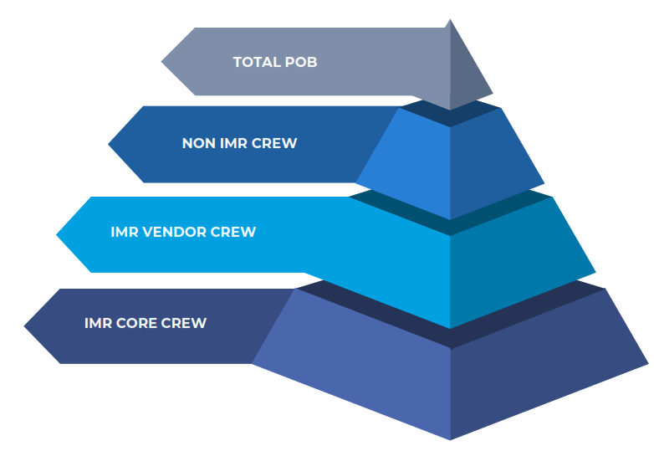
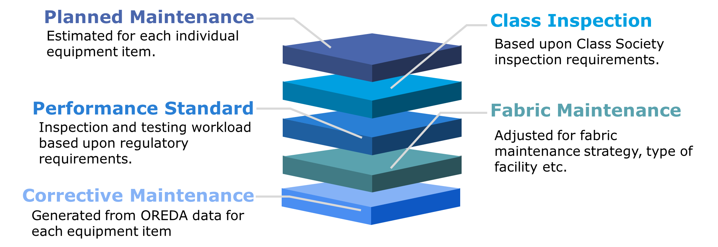
Inspection, Maintenance, and Repair Tool
The IMR Tool
Crondall Energy has an extensive track record of developing low staffing and unattended offshore energy facilities. We developed the Inspection, Maintenance, and Repair (IMR) Tool to allow clients to understand the life cycle IMR workload for their facilities, at any stage of the project lifecycle (i.e. concept, pre-FEED, etc.).
The IMR tool estimates the workload for all IMR activities throughout the facility life. This is a "Bottom up" estimate based on the facility equipment list.
The tool is highly customisable to accommodate the differing operating philosophies between regions and companies. Crondall works closely with their clients to ensure their corporate practices and experience are embedded into the model. Additionally, the tool can utilise varying levels of qualitative and quantitative information to analyse the IMR estimate.
The tool reports on these five IMR aspects of each equipment item :
The tool utilises this output to advise a total POB on an annual basis, throughout the life of the facility.
The POB is broken down by technician type (i.e. Operations, Electrical, etc) and support roles (i.e. management, HSE, hotel services, etc).
Our Service
Crondall Energy combines its technical expertise and operational experience with the IMR tool to provide the following services;
Estimating the accommodation size and adjust throughout the project development
Asses the opportunity to reduce offshore IMR hours,
Assess the impact of alternative operational strategies,
Assess the impact of digital tools,
Assess the impact of alternative process designs
Outputs from the tool are utilised by Crondall to perform the assessments detailed above. Typical outputs can include;
Effect of digital initiatives on workload
Workload breakdown (by work and technician type)
Effect of maintenance strategies
Sizing of accommodation
Identify “bad actors” that contribute most to technician workload
Impact of alternative equipment selection
Probabilistic estimate to understand impact of external factors (i.e. carry over work, upgrade work, etc)
Helping clients identify the most technically appropriate and cost- effective solutions to reduce their offshore maintenance burden.

Slide 2
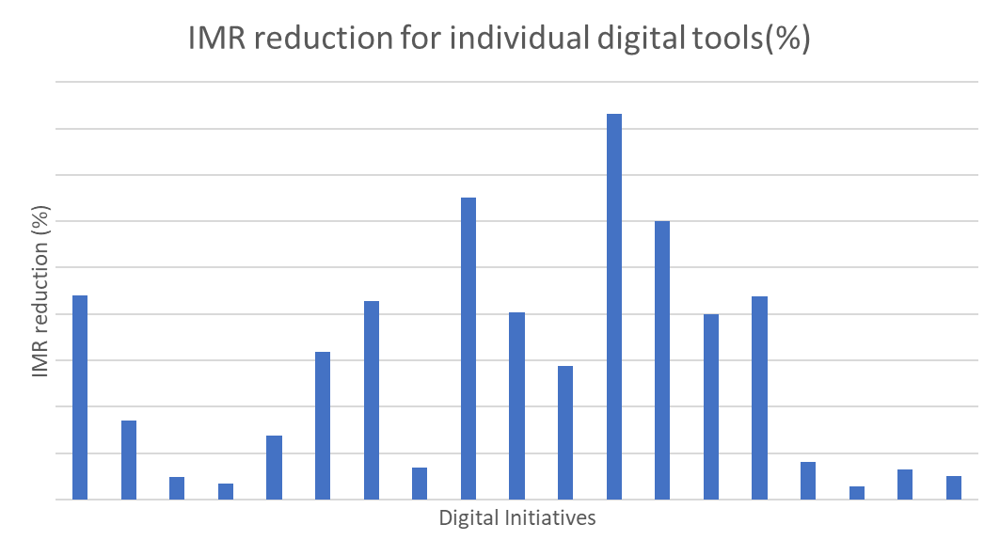
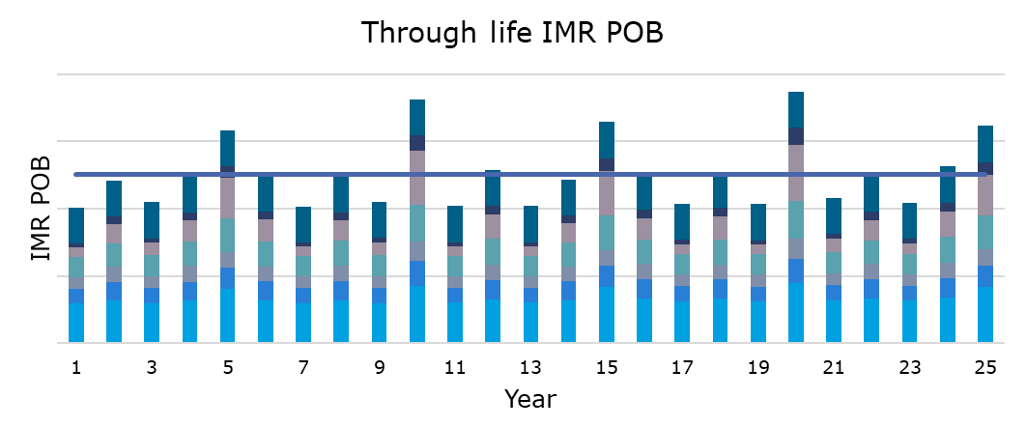
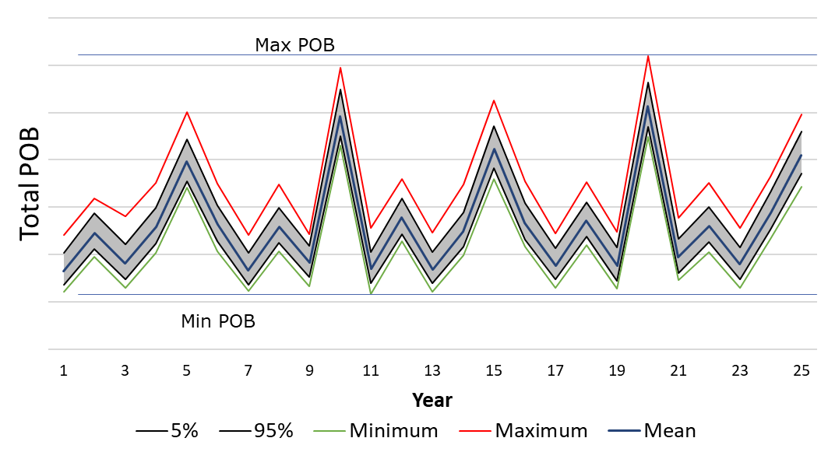
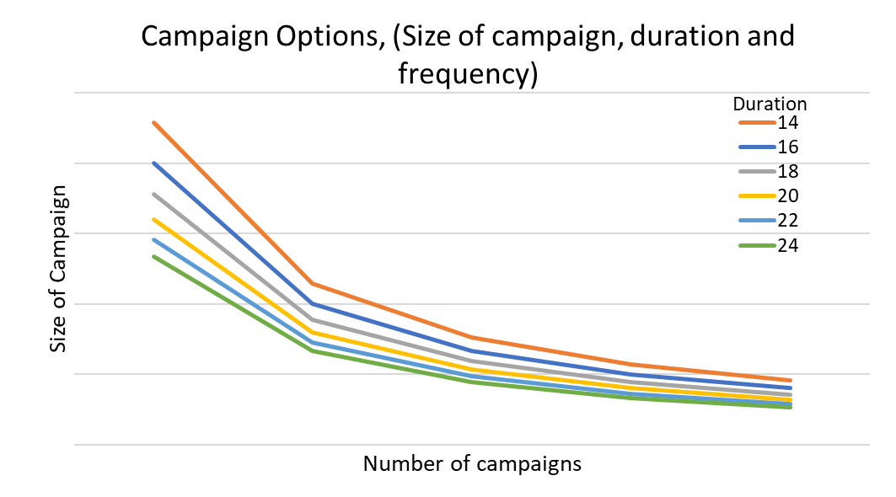
Inspection, Maintenance, and Repair Tool
Case Study: Concept Stage POB Estimate
Crondall Energy supported a client to assess their personnel requirements for a new build facility. The client's objective was for the new build facility was to deliver a significant reduction in offshore personnel. Crondall Energy’s role was to assess the impact of the design changes proposed and provide recommendations to size the accommodation.
Crondall Energy undertook several workshops to understand the clients current and future operating and maintenance strategy and gain buy-in from key stakeholders.
Crondall Energy then performed an IMR estimate for the new facility design over the field life to identify activities / equipment that contributed most to the IMR burden, as shown below:
Crondall Energy then utilised the IMR tool to perform a probabilistic estimate of the facilities POB (full field life) to understand the potential impact of external events as shown below:
These results quantified the benefit of the clients’ facility design changes, identify further opportunities to reduce IMR burden, and select an accommodation adequately sized for potential future external events.
Case Study: Assessing Digital Tools
Crondall Energy supported a client by providing an independent assessment of the impact of various digital initiatives and developing a roadmap for implementation to achieve these IMR workload savings.
Crondall Energy utilised the IMR tool to develop an estimate of the facilities IMR burden. Crondall Energy then performed an assessment of the digital tools, clearly identifying the IMR activities that could be modified or reduced as result. Providing the client with a clear quantifiable impact of the proposed tools. Crondall Energy then provided a cost of implement enation to enable the client to build a business case for implementation.
Case Study: Alternate Operation Strategies
Crondall Energy helped their client to assess the potential benefits and implementation of campaign maintenance. This review utilises the IMR tool to identify the potential campaign duration, frequency, and technician volume.

