Slide 1
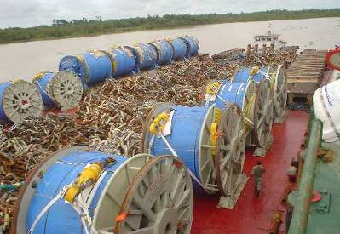
Expert Witness Services
Expert witness services
Crondall Energy’s technical experts offer a comprehensive expert witness capability for the full-spectrum of floating production and subsea engineering, construction and operational issues.
Crondall Energy’s worldwide operations enable our experts to combine local knowledge with global best practice. This offers an unparalleled breadth of experience of the appropriate technologies and practices employed on projects globally that can be used to support client’s disputes.
Crondall Energy’s team comprises a diverse range of technical specialists with the education, training and years of industry experience necessary to make the informed judgements required of an expert witness and to provide an opinion on technical matters during the preliminary development of a case. A number of Crondall Energy’s team have specific training and experience as expert witnesses.
Crondall Energy leverages this significant project experience to deliver credible expert witness services in a wide range of key areas including:
Project management and project delivery;
Project cost and schedule issues;
FPSO and FLNG topsides design, specification and operation;
Hull and topsides structural design including structural fatigue;
Turret mooring and riser design;
FPSO installation;
Operational issues;
Subsea equipment and production systems;
Subsea pipelines, risers and umbilicals.
Track record
Crondall Energy engineers have provided expert witness support to a number of confidential projects. Past services include:
FPSO structural failure;
FPSO project cost disputes;
Pipeline buckling (both lateral and upheaval);
Subsea component failure;
Pipeline and riser installation failures;
Pipeline anchor damage dispute;
Tax and valuation disputes;
Ready for startup disputes.
Case Study - R&D tax claim
Crondall Energy provided expert witness services for an R&D tax dispute.
Crondall Energy’s team reviewed contemporary FPSO designs of comparable size; throughput and regulatory regime to identify the state of technology at the time of the FPSO project delivery.
Thereafter, Crondall Energy’s engineers reviewed a large number of the project’s FEED and detailed design deliverables to identify what might or might not have qualified as R&D expenditure at the time the project was executed.
Crondall Energy produced a detailed technical report outlining specific design features and scope areas that were non-standard and could potentially qualify for tax relief.

